Slide 1
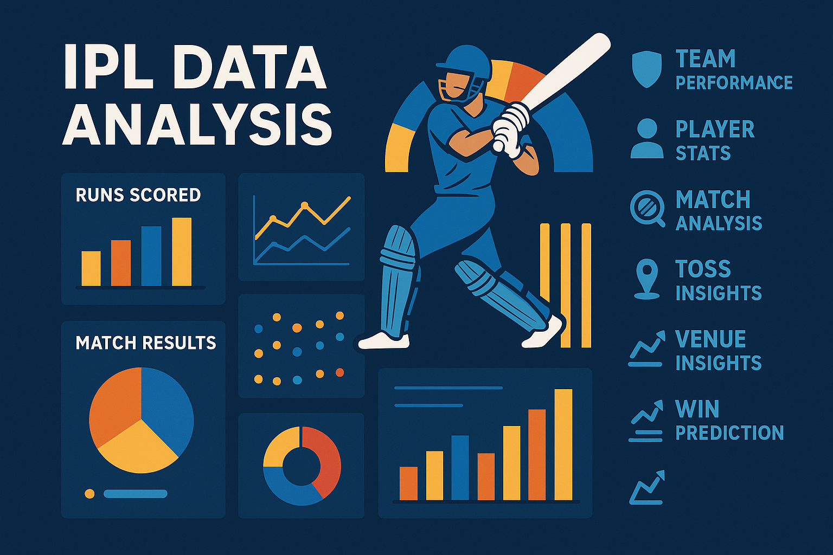

Slide 2


THE
INSIGHT INDEX
INDIAN FREMEIR LEAGUE 2008-2014 DATA ANALYSIS

Slide 3
Season | Matches | Wins | Losses | WinPct | RunsScored | RunsConceded | AvgRunsFor | AvgRunsAgainst | NetRunRate
2007/08 | 14 | 7 | 7 | 50.0 | 2080 | 2096 | 148.57 | 149.71 | 0.25
2009 | 13 | 5 | 8 | 38.46 | 1897 | 1802 | 145.92 | 138.62 | 0.14
2009/10 | 16 | 11 | 5 | 68.75 | 2738 | 2417 | 171.12 | 151.06 | 0.773
2011 | 16 | 10 | 6 | 62.5 | 2288 | 2283 | 143.0 | 142.69 | -0.016
2012 | 17 | 10 | 7 | 58.82 | 2462 | 2530 | 144.82 | 148.82 | -0.201
2013 | 19 | 13 | 6 | 68.42 | 2975 | 2832 | 156.58 | 149.05 | 0.276
2014 | 15 | 7 | 8 | 46.67 | 2353 | 2346 | 156.87 | 156.4 | 0.061
2015 | 16 | 10 | 6 | 62.5 | 2734 | 2694 | 170.88 | 168.38 | 0.168
2016 | 14 | 7 | 7 | 50.0 | 2194 | 2190 | 156.71 | 156.43 | -0.076
2017 | 17 | 12 | 5 | 70.59 | 2800 | 2645 | 164.71 | 155.59 | 0.634
2018 | 14 | 6 | 8 | 42.86 | 2380 | 2282 | 170.0 | 163.0 | 0.283
2019 | 16 | 11 | 5 | 68.75 | 2670 | 2569 | 166.88 | 160.56 | 0.33
2020/21 | 16 | 11 | 5 | 68.75 | 2758 | 2517 | 172.38 | 157.31 | 1.083
2021 | 14 | 7 | 7 | 50.0 | 2117 | 2128 | 151.21 | 152.0 | 0.174
2022 | 14 | 4 | 10 | 28.57 | 2217 | 2351 | 158.36 | 167.93 | -0.589
2023 | 16 | 9 | 7 | 56.25 | 2945 | 2954 | 184.06 | 184.62 | -0.044
2024 | 14 | 4 | 10 | 28.57 | 2568 | 2660 | 183.43 | 190.0 | -0.287
MUMBAI INDIANS
INDIAN FREMEIR LEAGUE 2008-2014 DATA ANALYSIS

Slide 4
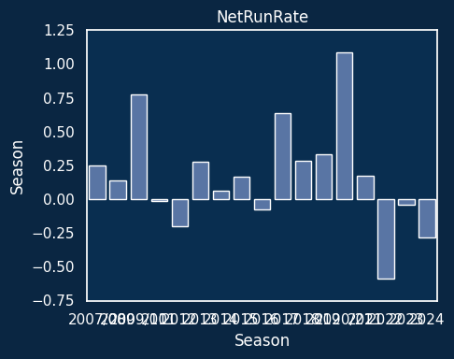
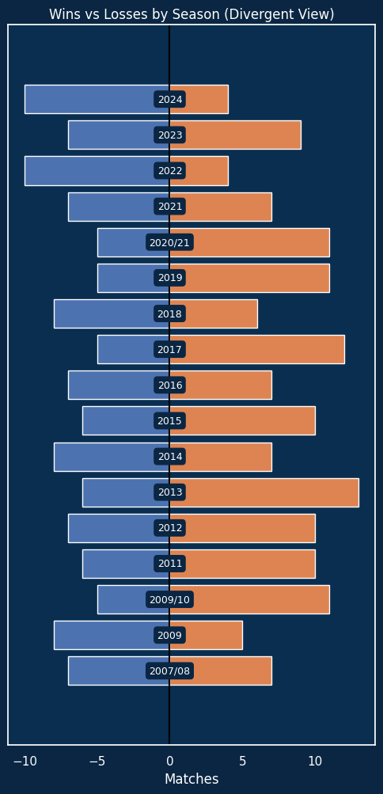
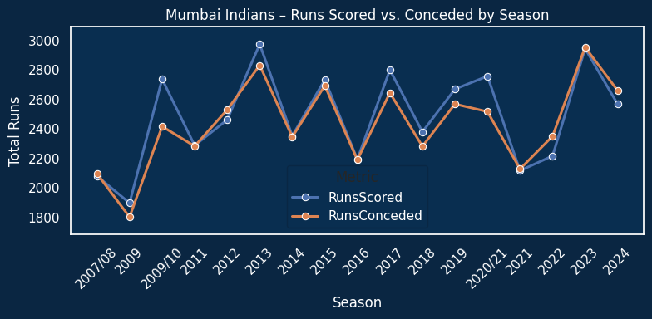
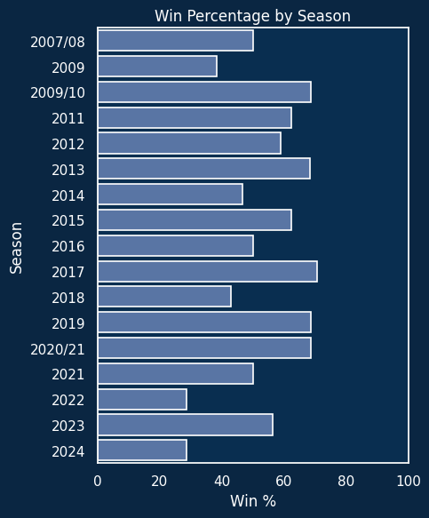
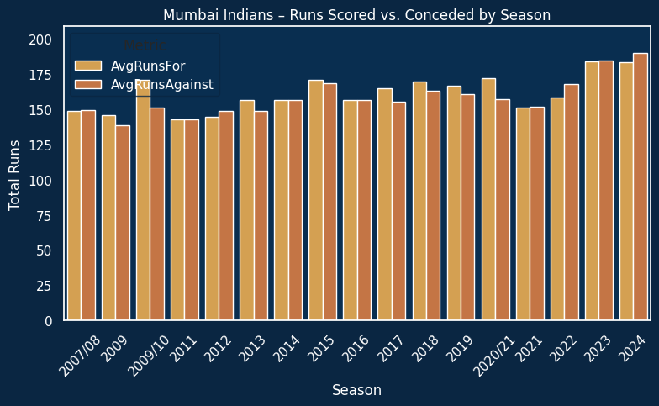
INDIAN FREMEIR LEAGUE 2008-2014 DATA ANALYSIS

Slide 5
VIRAT KOHLI
Runs Scored | Balls Faced | Strike Rate | Batting Average | Fours | Sixes | Dot Ball % | 50s / 100s | Dismissal Types | Consistency | Boundary % | Runs per Match | High Score | Batting Impact Score
8014 | 6069 | 132.05 | 38.71 | 708 | 273 | 33.47 | 56 / 8 | {'caught': 138, 'bowled': 39, 'lbw': 12, 'run ... | 47.13 | 55.78 | 32.84 | 113 | 4337.02
Wickets Taken | Overs Bowled | Economy Rate | Bowling Average | Bowling Strike Rate | Dot Ball % | Maiden Overs | Best Bowling Figures | 4-Wicket Hauls | 5-Wicket Hauls | Wide Balls | No Balls | Runs Conceded | Bowling Impact Score
4 | 41.83 | 8.87 | 92.75 | 62.75 | 20.72 | 0 | 2/25 | 0 | 0 | 7 | 6 | 371 | 9.73
Catches | Run Outs | Stumpings | Direct Hits | Dismissals Involved | Fielding Impact Score
114 | 17 | 0 | 17 | 131 | 1116
Batter | Runs | Balls | Strike Rate | Fours | Sixes | Match ID | Date | City | Venue | Batting Team | Opponent
V Kohli | 113 | 48 | 235.42 | 12 | 8 | 980999 | 2016-05-18 | Bangalore | M Chinnaswamy Stadium | Royal Challengers Bangalore | Kings XI Punjab
INDIAN FREMEIR LEAGUE 2008-2014 DATA ANALYSIS

Slide 6
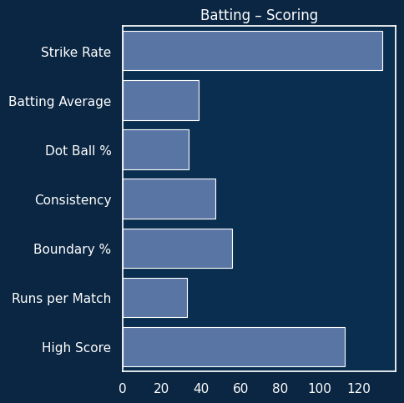
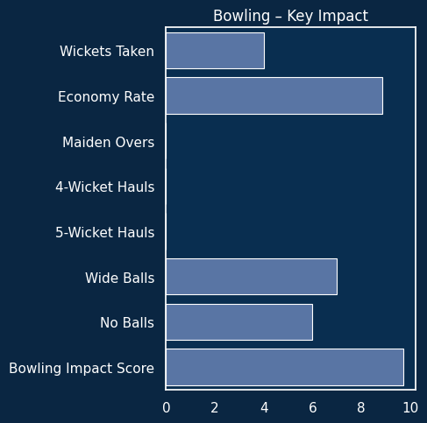
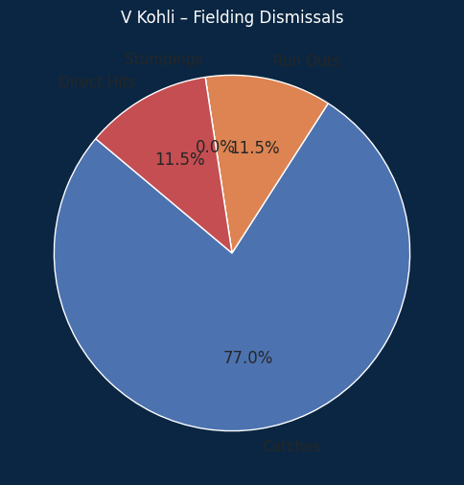

INDIAN FREMEIR LEAGUE 2008-2014 DATA ANALYSIS

Slide 7
Top Bowler As Per All Season
Top Batsman As Per All Season
Player | Wickets | Overs | RunsConceded | Economy | Average | StrikeRate
YS Chahal | 205 | 586.833333 | 4681 | 7.98 | 22.83 | 17.18
PP Chawla | 192 | 641.666667 | 5179 | 8.07 | 26.97 | 20.05
DJ Bravo | 183 | 520.000000 | 4436 | 8.53 | 24.24 | 17.05
B Kumar | 181 | 651.666667 | 5051 | 7.75 | 27.91 | 21.60
SP Narine | 180 | 680.166667 | 4672 | 6.87 | 25.96 | 22.67
R Ashwin | 180 | 754.000000 | 5435 | 7.21 | 30.19 | 25.13
A Mishra | 174 | 561.833333 | 4193 | 7.46 | 24.10 | 19.37
SL Malinga | 170 | 471.333333 | 3486 | 7.40 | 20.51 | 16.64
JJ Bumrah | 168 | 512.500000 | 3840 | 7.49 | 22.86 | 18.30
RA Jadeja | 160 | 638.166667 | 4917 | 7.70 | 30.73 | 23.93
Player | Runs | Balls | StrikeRate
V Kohli | 8014 | 6051 | 132.44
S Dhawan | 6769 | 5304 | 127.62
RG Sharma | 6630 | 5039 | 131.57
DA Warner | 6567 | 4682 | 140.26
SK Raina | 5536 | 4025 | 137.54
MS Dhoni | 5243 | 3790 | 138.34
AB de Villiers | 5181 | 3400 | 152.38
CH Gayle | 4997 | 3331 | 150.02
RV Uthappa | 4954 | 3784 | 130.92
KD Karthik | 4843 | 3570 | 135.66
INDIAN FREMEIR LEAGUE 2008-2014 DATA ANALYSIS

Slide 8
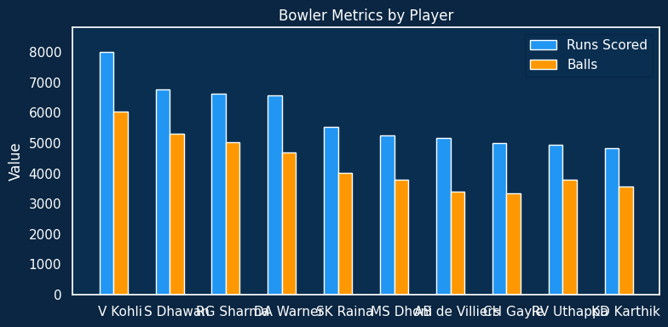
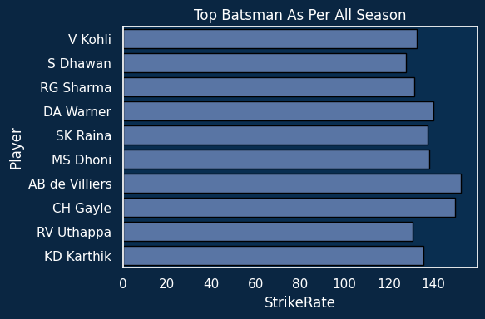
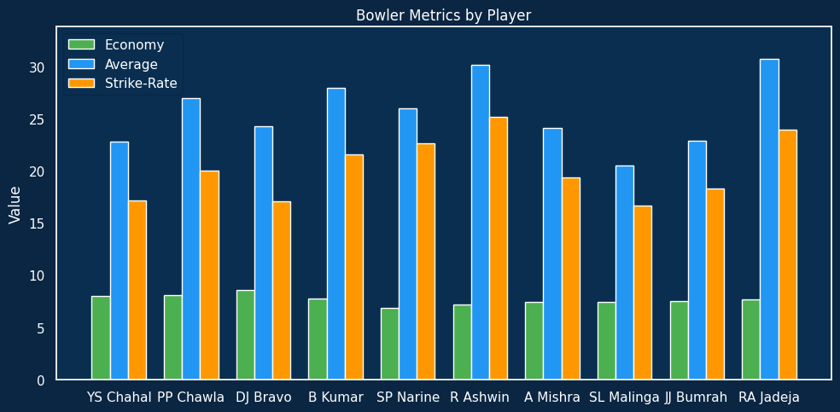
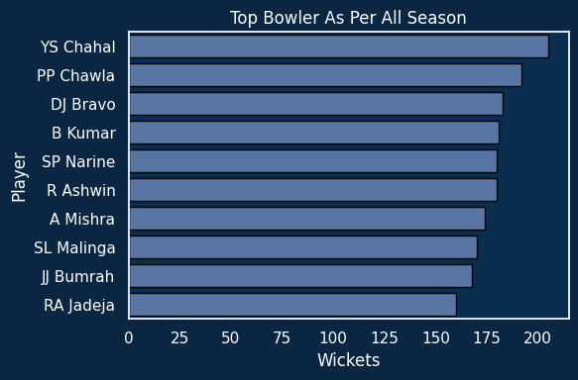
INDIAN FREMEIR LEAGUE 2008-2014 DATA ANALYSIS

Slide 9
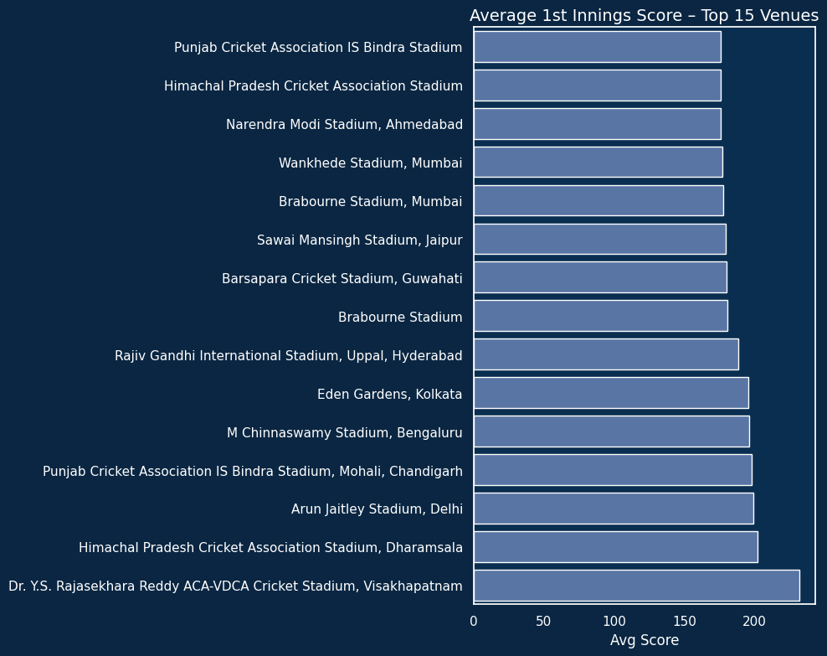
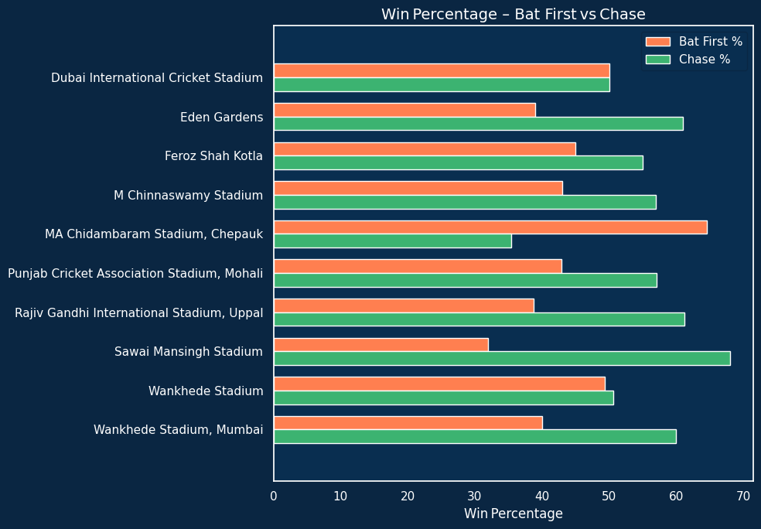
INDIAN FREMEIR LEAGUE 2008-2014 DATA ANALYSIS

Slide 10
Team | Matches Analysed | Field First (%) | Toss Winner Won Match (%)
Overall (All Teams) | 1095 | 64.29 | 50.59
Chennai Super Kings | 238 | 56.30 | 53.78
Deccan Chargers | 75 | 50.67 | 54.67
Delhi Capitals | 91 | 73.63 | 49.45
Delhi Daredevils | 161 | 58.39 | 51.55
Gujarat Lions | 30 | 90.00 | 73.33
Gujarat Titans | 45 | 68.89 | 51.11
Kings XI Punjab | 190 | 67.37 | 46.84
Kochi Tuskers Kerala | 14 | 64.29 | 57.14
Kolkata Knight Riders | 251 | 66.14 | 53.39
Lucknow Super Giants | 44 | 68.18 | 45.45
Mumbai Indians | 261 | 65.52 | 49.81
Pune Warriors | 46 | 39.13 | 41.30
Punjab Kings | 56 | 80.36 | 46.43
Rajasthan Royals | 221 | 61.09 | 49.32
Rising Pune Supergiant | 16 | 87.50 | 62.50
Rising Pune Supergiants | 14 | 57.14 | 57.14
Royal Challengers Bangalore | 240 | 70.00 | 51.25
Royal Challengers Bengaluru | 15 | 86.67 | 53.33
Sunrisers Hyderabad | 182 | 61.54 | 45.05
Matches Analysed | Field First (%) | Toss Winner Won Match (%)
1095 | 64.292237 | 50.593607
Decision | Count
bat | 391
field | 704
INDIAN FREMEIR LEAGUE 2008-2014 DATA ANALYSIS

Slide 11
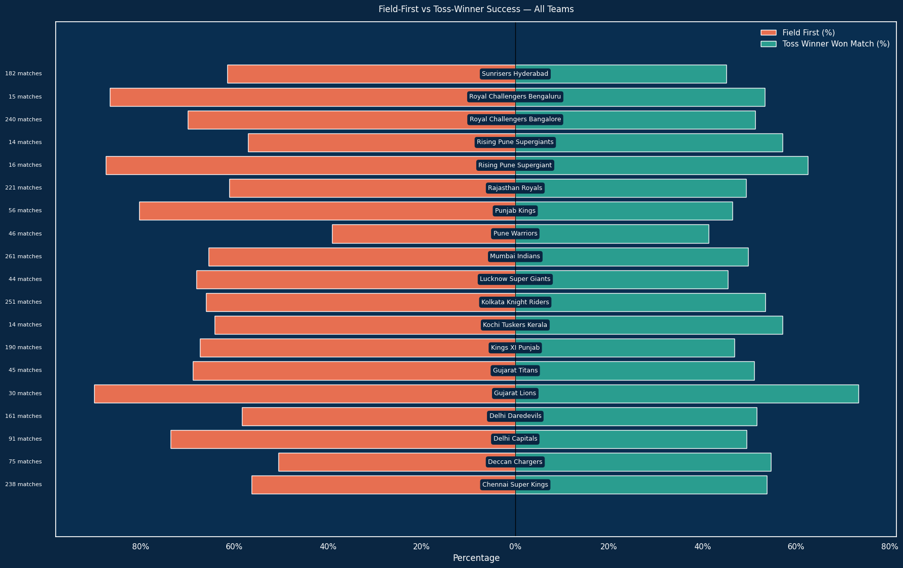
INDIAN FREMEIR LEAGUE 2008-2014 DATA ANALYSIS

